Slide 1
INTRODUCTION
HUYNH THANH QUAN

Slide 2
Background and Experience
Vietnamese German University
Electrical Engineering and Information Technology
April – 2018
Robert Bosch Vietnam Engineering
Internship | Feb – 2017 to July – 2017
Practice and enhance Java skills
Learn and examine the source control management
Software Engineer | Aug – 2017 to Dec – 2018
Java Plug-in, Java Spring MVC
Develop for source control management system Rational Team Concert and Application Lifecycle Management (GitHub)
Data Science | Jan – 2018 to June – 2018
Statistic, Python, Machine Learning, Data visualization, NLP
Research AI to apply automation business in Quality Risk Management

Slide 3
Theme: Quality Risk Manager 2018年07月27日
Team
Team: Agility Practice
Leader: Oyu Satoshi
Members: Kubota, Sakai, Akasofu, Quan
Background and What to Achieve
When a software developer commits code into source code, there is possibility that the commit includes bug
If a tool can predict the commit including bug or not, the developer will review the commit and prevent from committing bugs
To reduce human effort in evaluating bug commits, our team has built a machine learning model for such cases

Slide 4




Theme: Quality Risk Manager
Overview

Slide 5

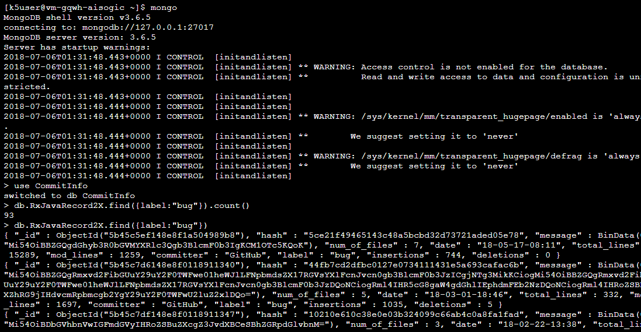
Theme: Quality Risk Manager
Database
Manage database
Import and export data
Query data

Slide 6
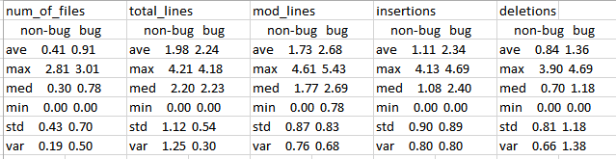
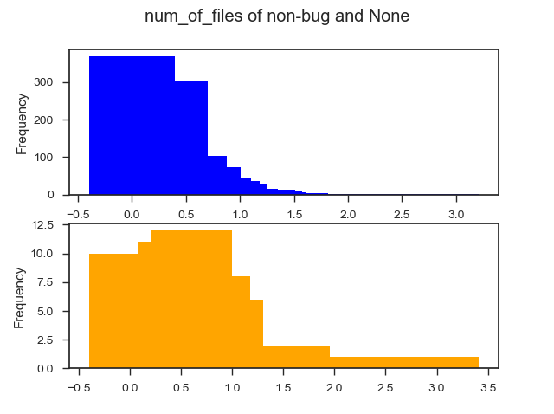
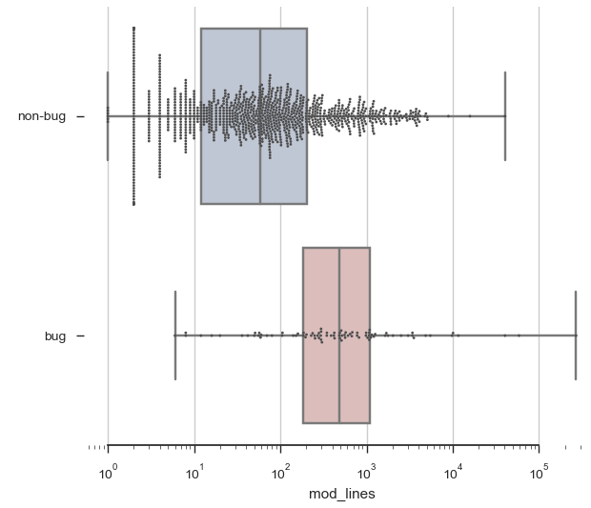
Theme: Quality Risk Manager
Statistic

Slide 7
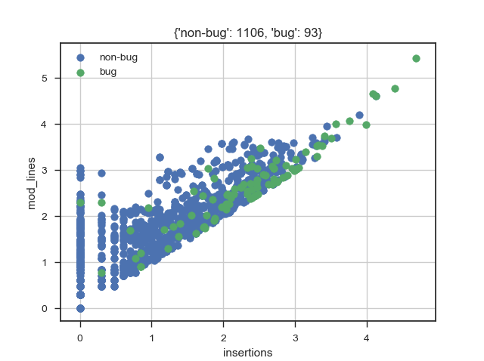
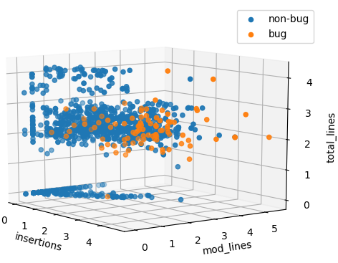
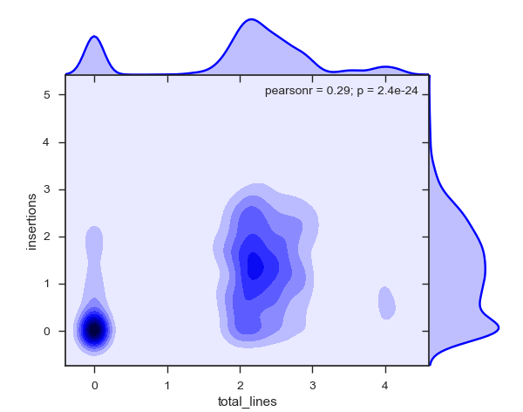
Theme: Quality Risk Manager
Data Visualization

Slide 8
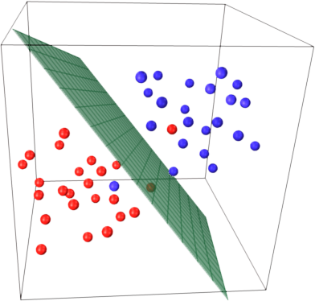
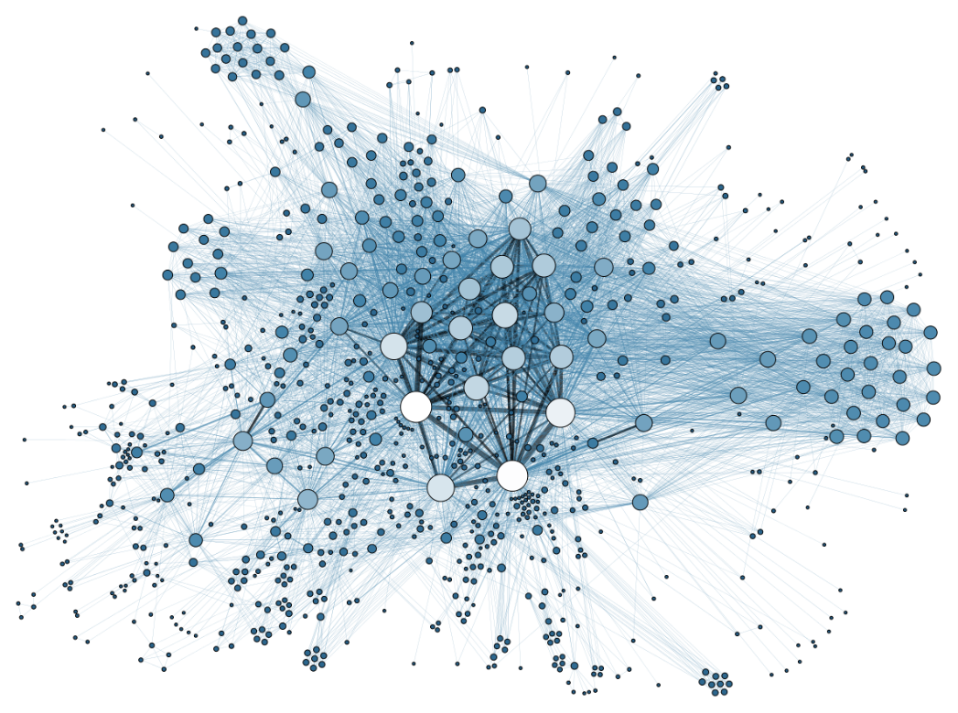
Theme: Quality Risk Manager
Used Technologies
Support Vector Machine
Neural Network

